Slide 1
regional bike routes ARE FOR everybody
Or… The benefits of commuter bicycle route awareness and identification to the travelling public: implementing non-motorized elements in the Kalamazoo area transportation study’s 2045 metropolitan transportation plan
Notes:
This presentation was prepared by Doug Plachcinski with input from members of the Kalamazoo Region Bike Route Committee. It is meant to be modified and used as you see best in your situation.

Slide 2

Transportations moves something from one place to another
Source: https://countrynews-uploads-prod.s3.amazonaws.com/2016/Nov/21/asset_12ZvykNpbCtTKqvHrERk.jpg?time=1479875312

Slide 3
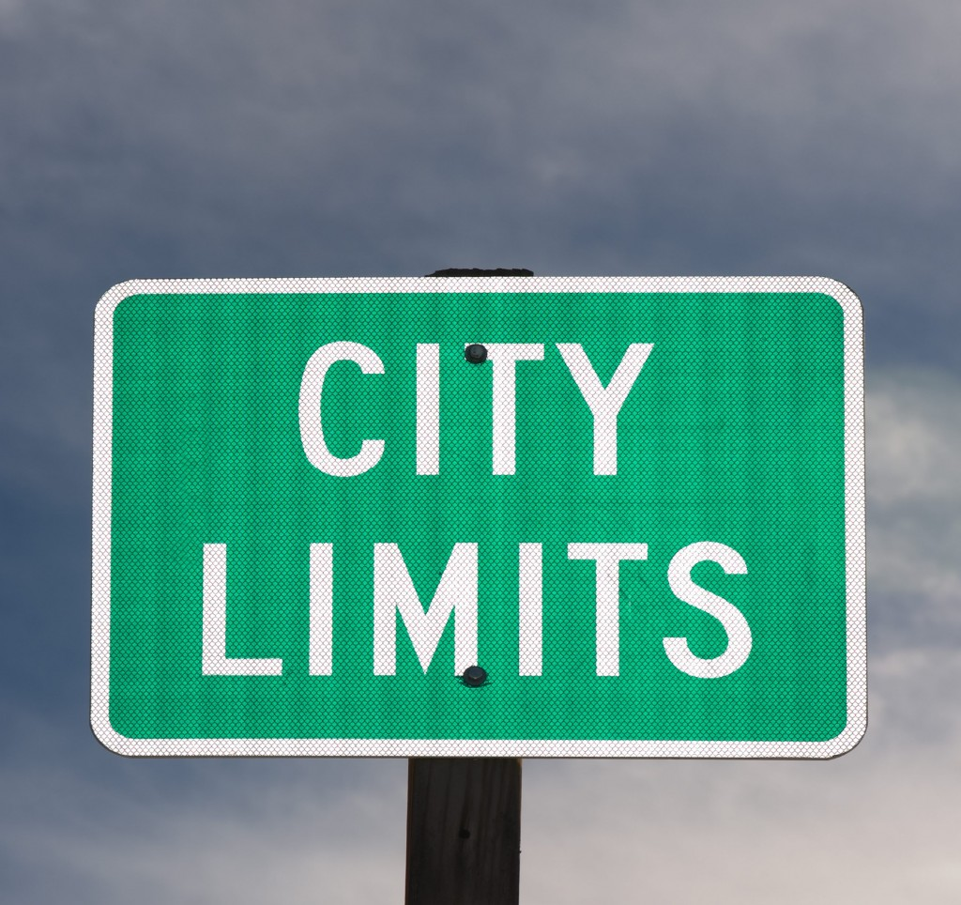
Bicycling, like any other way of moving, doesn’t care about borders
Notes:
City, Township, Village, County, State- crossing these lines doesn’t matter to the traveler, no matter the method. We still need a safe road for all the legally authorized ways to use it. Transportation is a destination-based process. If I need to get to work, I don’t care that Portage maintains half the length of road and the KCRC the other half. Current road wayfinding frequently tells us where we are at, but not a whole lot about where we want to go. Also, no matter how navigation technology evolves, we still need visual queues.

Slide 4
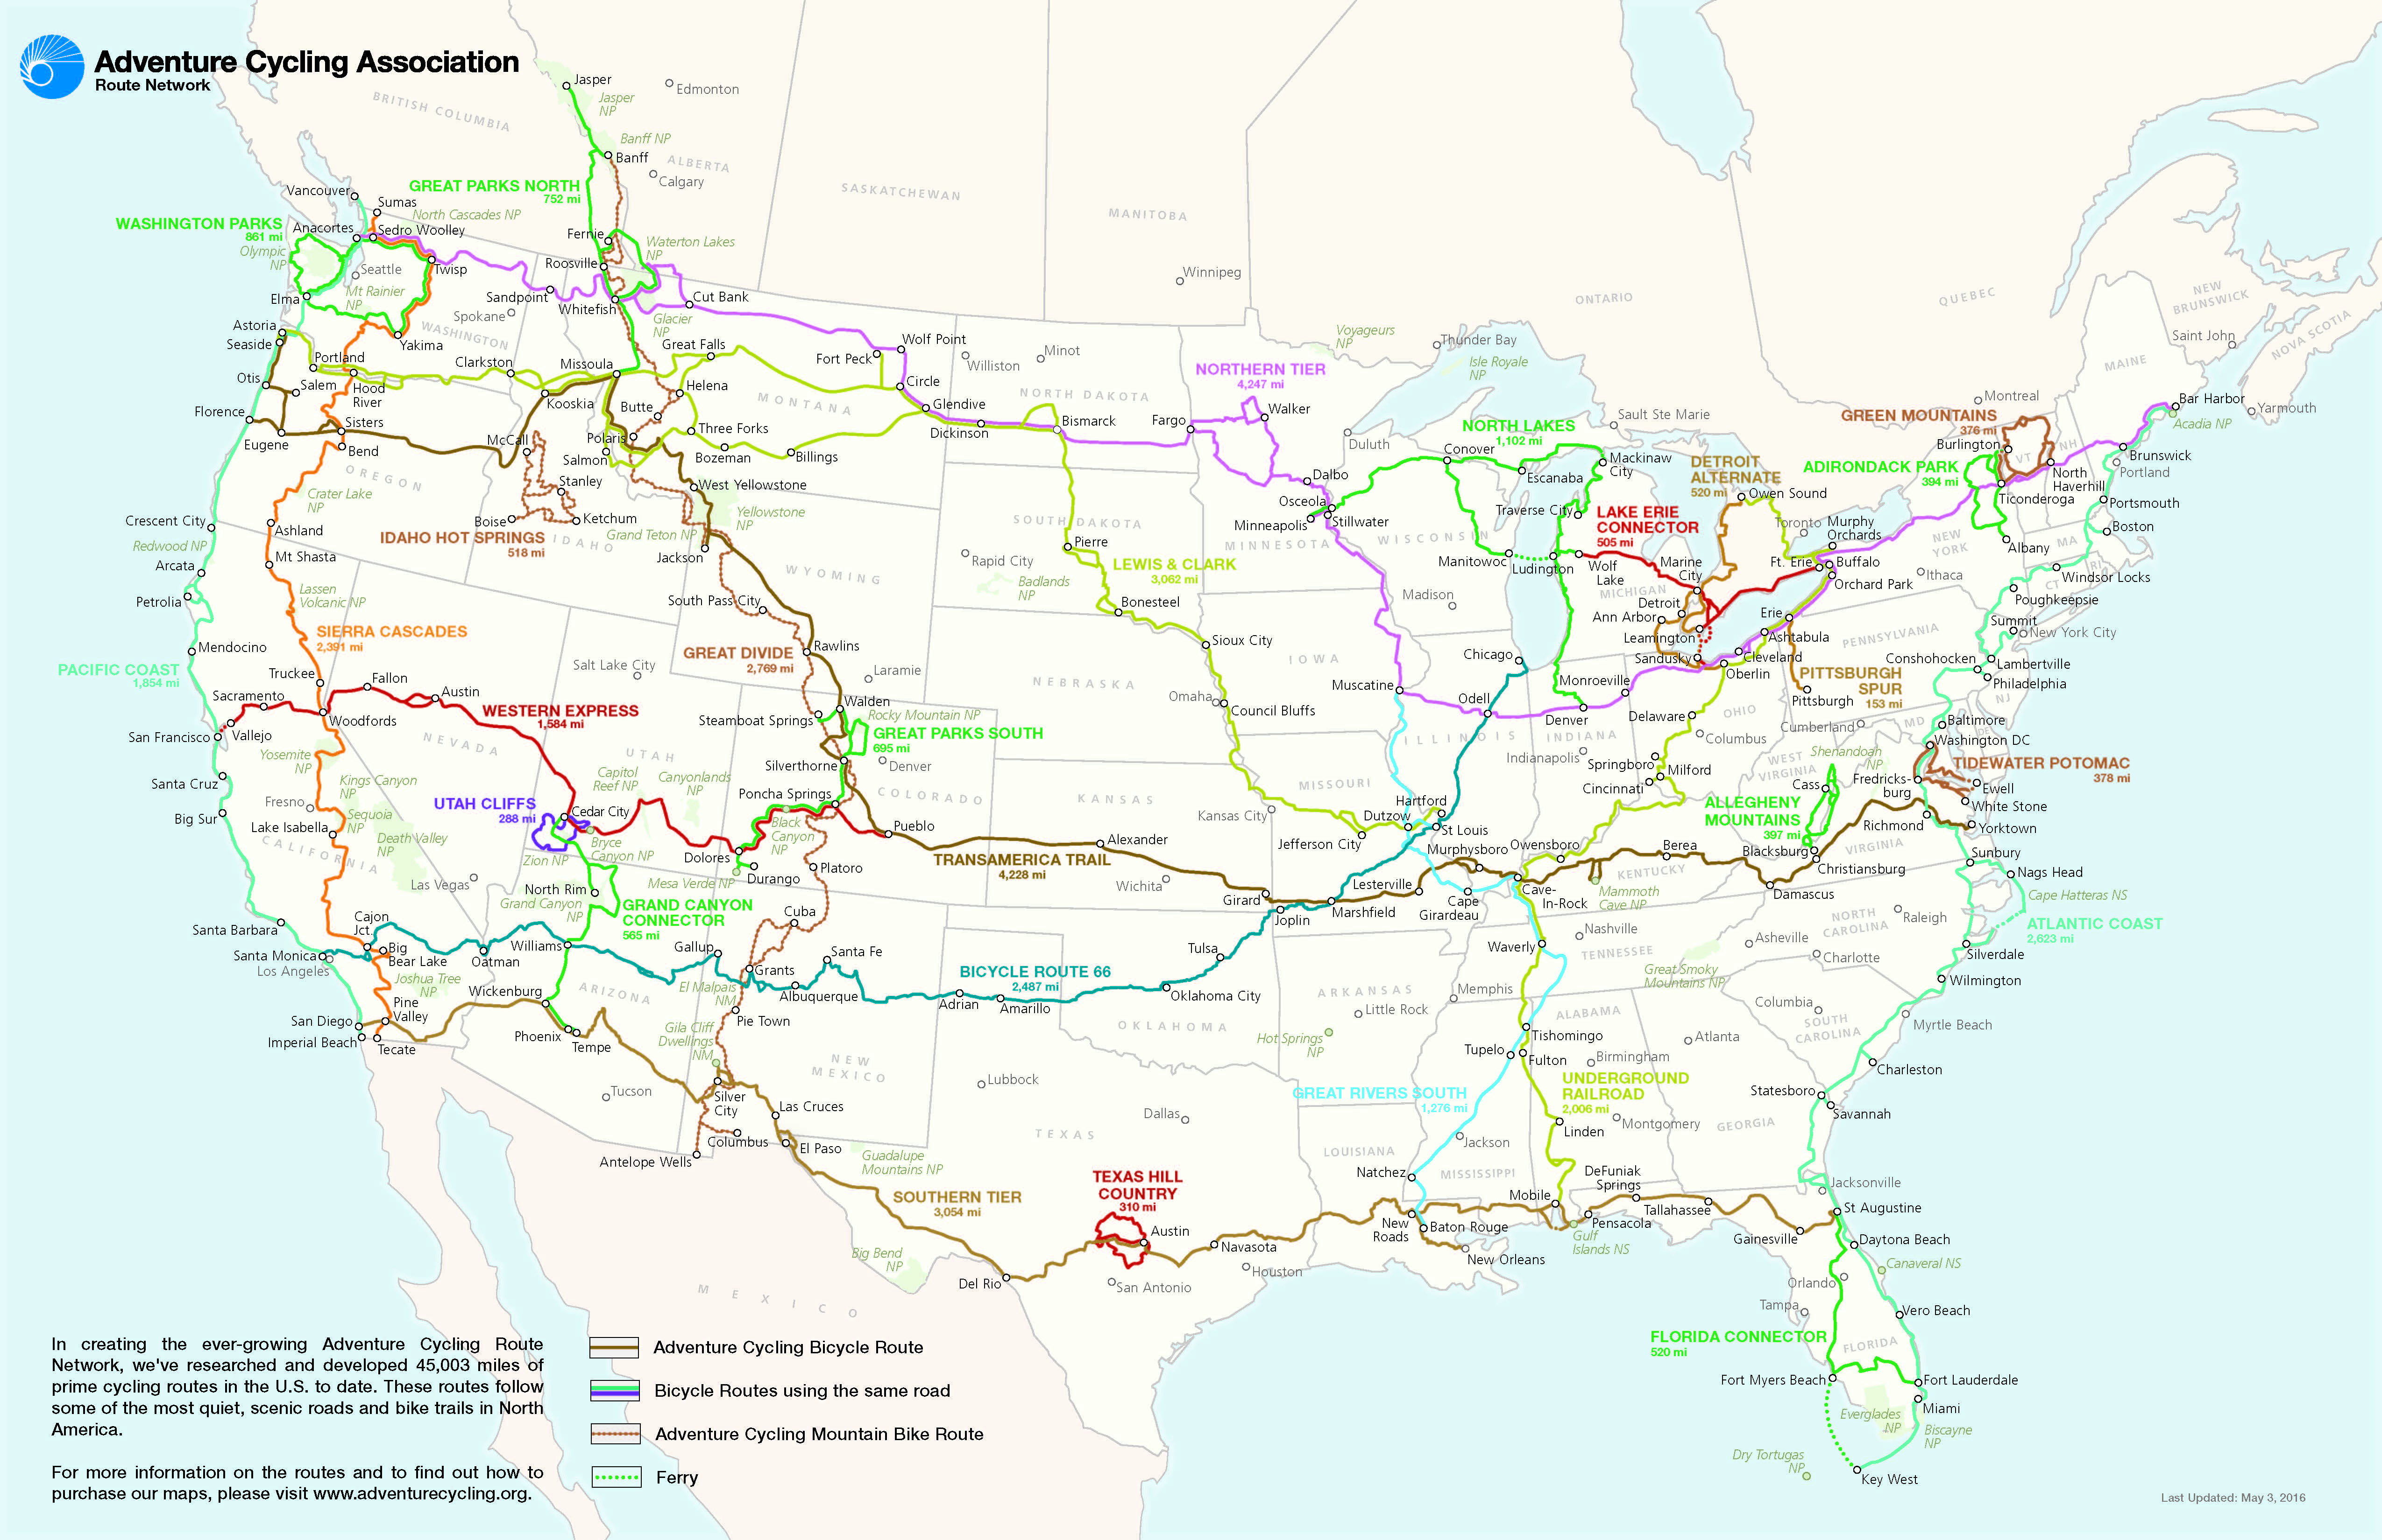
Familiarizing Users with the network
Source: https://www.adventurecycling.org/routes-and-maps/adventure-cycling-route-network/interactive-network-map/
Notes:
Understanding route identification benefits draws from several resources, including AASHTO, NACTO, MDOT, and documentation from other programs like Chicago
NACTO’s guide for bike route wayfinding lists the following benefits for signed bicycle routes:
• Familiarizes users with the bicycle network.
• Identifies the best routes to destinations.
• Overcomes a “barrier to entry” for infrequent bicyclists.
• Signage that includes mileage and travel time to destinations may help minimize the tendency to overestimate the amount of time it takes to travel by bicycle.
• Visually indicates to motorists that they are driving along a bicycle route and should use caution.
• Passively markets the bicycle network by providing unique and consistent imagery throughout the jurisdiction.

Slide 5

Identifying the best route (and maybe alternative routes)
SOURCE: http://leighloueygung.com/wp-content/uploads/2013/11/fork_in_the_road.jpg
Notes:
Where do we go, how do we decide? What factors into the decision making process? Typically time, distance, and speed are factors. Cyclists of all skill sets calculate the time left of the trip from the remaining distance.
Signage that includes mileage and travel time to destinations may help minimize the tendency to overestimate the amount of time it takes to travel by bicycle.

Slide 6
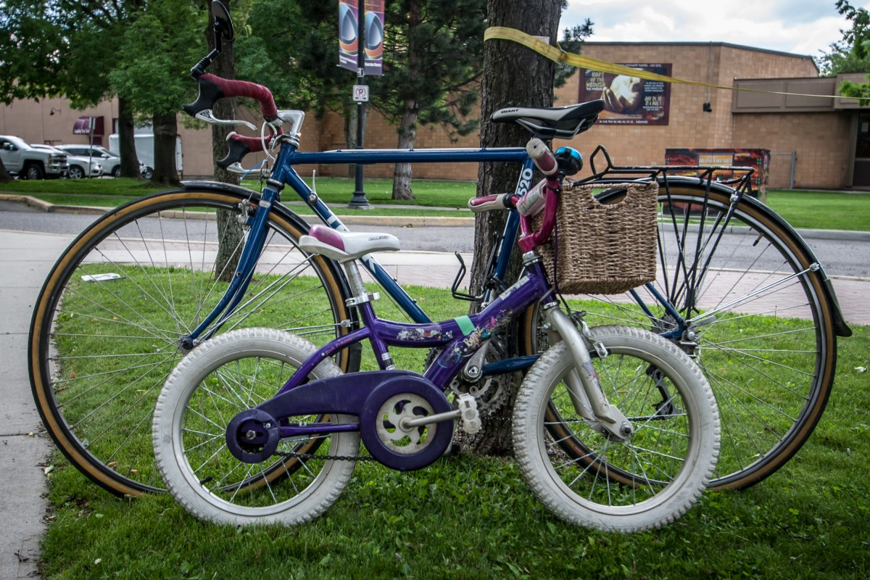
ENCOURAGES NEW CYCLISTS
Notes:
Inexperienced cyclists should use extreme caution bicycling in roads and streets. However, bike route signage such as we see in many communities presents a constant reminder that roads are a place for cyclists too, with benefits for the whole community. These reminders can also tell motorists and non-motorists alike that we must share the road, possibly reducing dangerous feelings of “us” vs. “them” and creating a more friendly culture of community for everyone.

Slide 7

COST-Effective connections – Including Links Among other Bicycling and OTHER facilities
Notes:
Bike route signage is one of the most cost-effective forms of bicycling amenity that a community can invest in. Bike routes can link communities, but it can also be used to bridge gaps among other facilities, including among other bicycling and transportation facilities.

Slide 8
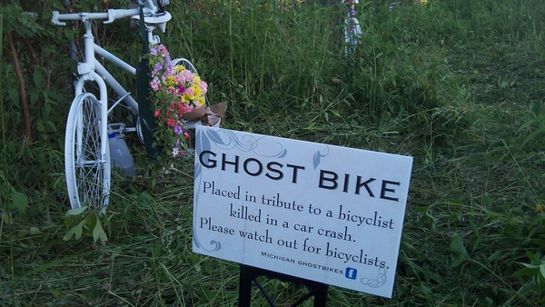
IMPROVING SAFETY AWARENESS FOR ALL ROAD USERS
Photo Credit: John McNeill
Notes:
Bikes are a legal form of transportation. Crashes involving a bicycle and a vehicle usually are harder on the cyclist. NACTO states that bike routes create a visual reminder that bicyclists can be expected on the roads, so caution should be used. Some people say that “nothing” could have stopped a person who is crazy from tragedies like we have experienced. With respect, no one can know whether a more positive attitude toward non-motorized users such as bicyclists might have made even a crazy person think twice. Or whether the friends or family of such people might have taken a positive action that could have avoided the situation. No one can know. But each of can try, using the resources we have access to.

Slide 9
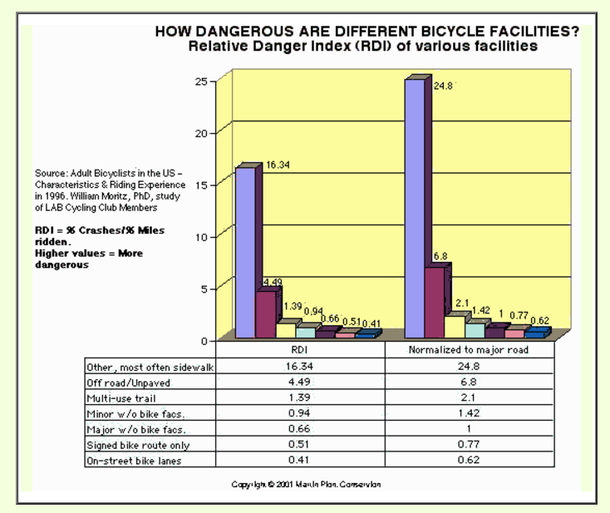
Bike Routes and the “Relative Danger Index”
Source: http://www.bikexprt.com/bikepol/facil/sidepath/sidecrash.htm
Notes:
And according to statistics used by the Michigan Department of Transportation, bike routes have been associated with a surprisingly low “relative danger index,” especially when compared to sidewalks, which often create many more opportunities for travel to move in unexpected directions and places, plus many more “intersections” – aka driveways -- to traverse.

Slide 10
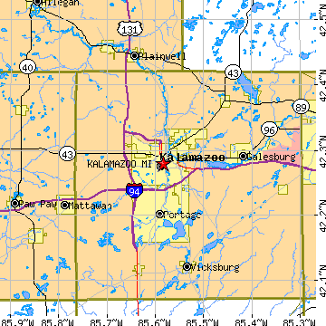
Regional & COMMUNITY
Awareness / PLACE-BUILDING
Notes:
Signing the bike routes mapped in the KATS 2045 Metropolitan Transportation Plan creates obvious marketing opportunities. The network can serve as a source of local pride. The regional pride will grow as the more links we complete.

